Slide 1
Welcome to ILMS

Slide 2
Login for returning users Register for first time users ***Contact*** Support@netdigitalsolutions.com for any issues or concerns with your account access

Slide 3
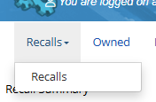
Where to access Recalls in ILMS?
The first item in the top ribbon. Click on the highlight portion labeled Recalls

Slide 4
Where to access Recalls in ILMS?

Slide 5
GSA information about RECALLS
https://gsafleet.gov/GSAFleet_gov-Recalls-User-Guide.pdf

Slide 6
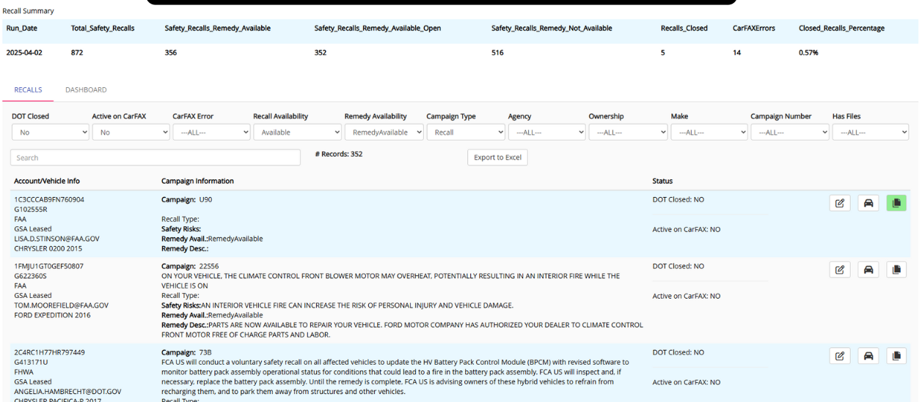
Recall Main Screen
Your page will give you an overview of all recalls
And a snapshot of your stats

Slide 7
Recall Main Screen
This page allows you and your team to have a summary of open vs closed recalls to track progress

Slide 8
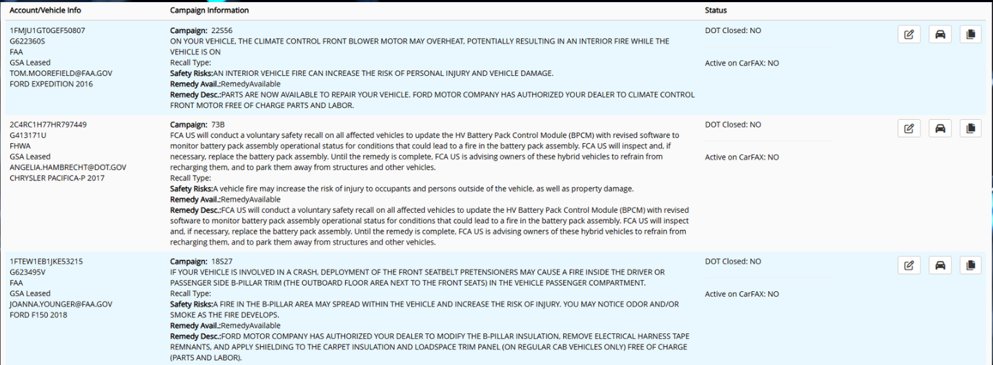
Recall Main Screen
Drivers or Agency Managers should review each recall. Once they have completed the recall in shop, the user will click the PENCIL icon to close it out.

Slide 9
Recall Navigation
Use these three buttons to navigate for each recall.
*Verify a completed recall
*Recall information
*Files

Slide 10
Recall Navigation

Slide 11
Recall Navigation

Slide 12
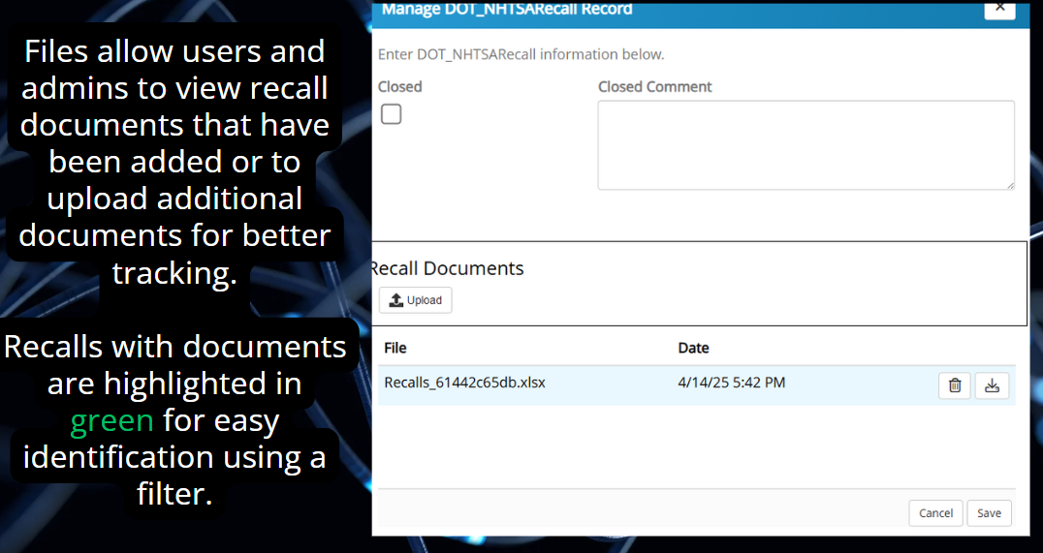
Recall Navigation

Slide 13
Recall Navigation

Slide 14
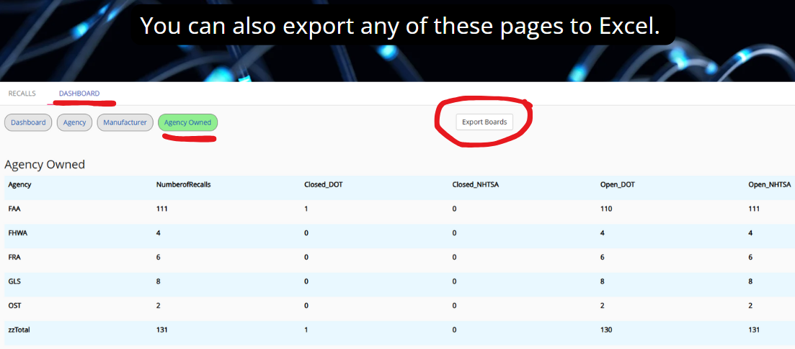
Recall Export

Slide 15
MORE to come….
Please feel free to provide leadership with suggestions as we continue to improve and streamline the recalls process.

